Slide 1
Analysis of Algorithm

Slide 2





Algorithms
A finite set of instructions or logic, written in order, to accomplish a certain predefined task.
Algorithm is not the complete code or program
It is just the core logic (solution) of a problem
Can be expressed either as an informal high level description as pseudo code or using a flowchart.

Slide 3


Characteristics of an Algorithm
Unambiguous − Algorithm should be clear and unambiguous.
Input − An algorithm should have 0 or more well defined inputs.
Output − An algorithm should have 1 or more well defined outputs
Finiteness − Algorithms must terminate after a finite no. of steps.
Feasibility − Should be feasible with the available resources.
Independent − An algorithm should have step-by- step directions which should be independent of any programming code.

Slide 4


Algorithm Analysis
An algorithm is said to be efficient and fast,
if it takes less time to execute
consumes less memory space.
The performance of an measured on the basis of
Time Complexity
Space Complexity
algorithm is

Slide 5

Space Complexity
The amount of memory space required by the algorithm in its life cycle.
A fixed part For example simple variables & constant used and program size etc.
A variable part For example dynamic memory allocation, recursion stacks space etc.
Space complexity S(P) of any algorithm P is
S(P) = C + SP(I)
Where C is the fixed part
S(I) is the variable part of the algorithm

Slide 6

Time Complexity - T(n)
The amount of time required by the algorithm to run to completion.
T(n) can be measured as the number of steps, provided each step consumes constant time.

Slide 7
Time Efficiency
worst case
average case
best case
Usually worst case is considered since it gives an upper bound on the performance that can be expected. Additionally, the average case is usually harder to determine (its usually more data dependent), and is often the same as the worst case. Under some circumstances it may be necessary to analyze all 3 cases (algorithms topic).

Slide 8
Orders of Growth
• We are more interested in the order of growth on the number of times the basic operation is executed on the input size of an algorithm. • Because, for smaller inputs, it is difficult to distinguish efficient algorithms vs. inefficient ones.
• For example, if the number of basic operations of two algorithms to solve a particular problem are n and n 2 respectively, then
– if n = 3, then we may say there is not much difference between requiring 3 basic operations and 9 basic operations and the two algorithms have about the same running time.
– On the other hand, if n = 10000, then it does makes a difference whether the number of times the basic operation is executed is n or n 2 .

Slide 9

Calculate time complexity
Single Statement
b=20;
a = b+10;
T(n) = constant (c)
Loop
for(i=0; i < N; i++)
{
statement;
}
T(n) = n
for(i=0; i < N; i++)
Double Loop
{
for(j=0; j < N;j++)
{
statement;
}
}
T(n) = N * N

Slide 10


Asymptotic Analysis
Asymptotic analysis refers to computing the running time of any operation in mathematical units of computation.
Ο Notation
Ω Notation
θ Notation

Slide 11
Big O notation
Definition: Let f(n) and g(n) be functions, where n is a positive integer. We write f(n) = O(g(n)) if and only if there exists a real number c and positive integer n₀ satisfying 0 <= f(n) <= cg(n) for all n >= n₀. (And we say, "f of n is big oh of g of n." We might also say or write f(n) is in O(g(n)), because we can think of O as a set of functions all with the same property. But we won't often do that in Data Structures.)

Slide 12

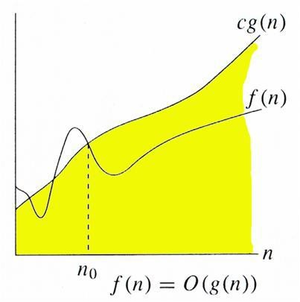
Big Oh Notation, Ο
It measures the worst case time complexity or longest amount of time an algorithm can possibly take to complete.
O(g(n)) = { f(n): there exist positive constants c and n0 such that
0 <= f(n) <= cg(n) for all n >= n0}

Slide 13
Omega -
f(n) = omega(g(n)), read as f of n is omega of g of n, iff (if and only if) positive constants c and n₀ e
xist such that f(n) >= cg(n) for all n, n >= n₀.
Theta -
f(n) = Theta(g(n)), read as f of n is theta of g of n, iff (if and only if)
positive constants c₁, c₂, and n₀ exist such that c₁g(n) <=f(n) <= c₂g(n) for all n, n >= n₀.
Little-O -
f(n) = o(g(n)), read as f of n is little oh of g of n, f(n) = O(g(n)) and f(n) != omega(g(n))

Slide 14

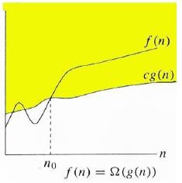
Ω Notation:
Ω notation provides an asymptotic lower bound

Slide 15

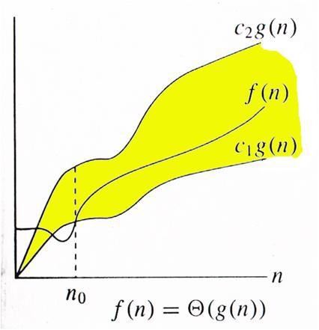
Θ Notation:
Θ((g(n)) = {f(n): there exist positive constants c1, c2 and n0 such that 0 <= c1*g(n) <= f(n) <= c2*g(n) for all n >= n0}

Slide 16


Mathematical Analysis
For Non-recursive Algorithms
There are four rules to count the operations:
🞄 Rule 1: for loops - the size of the loop times the
running time of the body
🞄 Find the running time of statements when executed only once
🞄 Find how many times each statement is executed
🞄 Rule 2 : Nested loops
🞄 The product of the size of the loops times the running time of the body
🞄 Rule 3: Consecutive program fragments
🞄 The total running time is the maximum of the running time of the
individual fragments
🞄 Rule 4: If statement
🞄 The running time is the maximum of the running times of if stmt
and else stmt.

Slide 17


Rule 1: for loops
for( i = 0; i < n; i++) // i = 0; executed only once: O(1)
// i < n; n + 1 times O(n)
// i++ n times O(n)
// total time of the loop heading:
// O(1) + O(n) + O(n) = O(n)
sum = sum + i; // executed n times, O(n)
The loop heading plus the loop body will give: O(n) + O(n) = O(n).
IF
The size of the loop is n (loop variable runs from 0, or
some fixed constant, to n)
The body has constant running time (no nested loops)
Loop running time is: O(n)

Slide 18

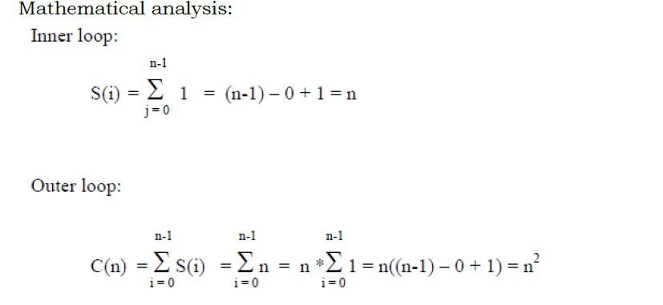
Rule 2 : Nested loops
sum = 0;
for( i = 0; i < n; i++)
for( j = 0; j < n; j++)
sum++;
Applying Rule 1 for the nested loop (the ‘j’ loop) we get O(n) for the body of the outer loop.The outer loop runs n times, therefore the total time for the nested loops will be O(n) * O(n) = O(n*n) = O(n^2)

Slide 19

for( i = 0; i < n; i++) for( j = i; j < n; j++)
sum++;
Here, the number of the times the inner loop is executed depends on the value of i
i = 0, inner loop runs n times
i = 1, inner loop runs (n-1) times i = 2, inner loop runs (n-2) times
…
i = n – 2, inner loop runs 2 times i = n – 1, inner loop runs once.
Thus we get: ( 1 + 2 + … + n) = n*(n+1)/2 = O(n^2)
Running time is the product of the size of the loops times the running time of the body.

Slide 20

Rule 3: Consecutive program fragment
sum = 0;
for( i = 0; i < n; i++)
sum = sum + i;
sum = 0;
for( i = 0; i < n; i++)
for( j = 0; j < 2*n; j++)
sum++;
The first loop runs in O(n) time, the second - O(n^2) time, the
maximum is O(n^2)
The total running time is the maximum of the running time of the individual fragments

Slide 21

Rule 4: If statement
if C
S1;
else
S2;
The running time is the maximum of the running times of S1 and S2.
The running time is the maximum of the running times of if stmt and else stmt

Slide 22

Exercise
a.
sum = 0;
for( i = 0; i < n; i++)
for( j = 0; j < n * n; j++) sum++;
Ans : O(n^3)
c.
sum = 0;
for( i = 0; i < n; i++)
for( j = 0; j < i*i; j++)
for( k = 0; k < j; k++)
sum++;
Ans : O(n^5)
d.
sum = 0;
for( i = 0; i < n; i++) sum++;
val = 1;
for( j = 0; j < n*n; j++)
val = val * j;
Ans : O(n^2)
b.
sum = 0;
for( i = 0; i < n; i++)
for( j = 0; j < i; j++)
sum++;
Ans : O(n^2)

Slide 23

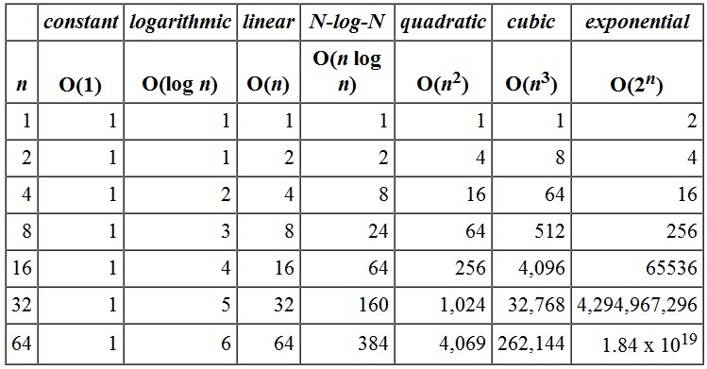
Order of Growth Function

Slide 24

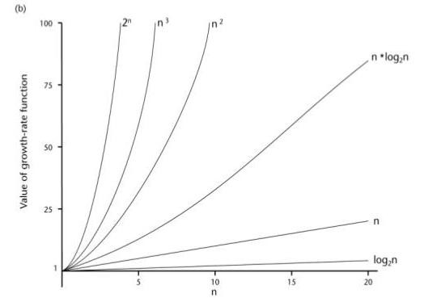

Slide 25

Linear Search Analysis
linear(a[n], key)
for( i = 0; i < n; i++)
if (a[i] == key)
return i;
else return -1;
Worst Case : O(n) // Rule 1 for loop explanation
Average Case :
If the key is in the first array position: 1 comparison
If the key is in the second array position: 2 comparisons
...
If the key is in the ith postion : i comparisons
...
So average all these possibilities: (1+2+3+...+n)/n = [n(n+1)/2] /n = (n+1)/2
comparisons.
The average number of comparisons is (n+1)/2 = Θ(n).
Best Case : O(1)

Slide 26

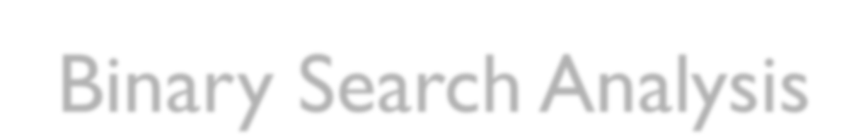
Binary Search Analysis
binarysearch(a[n], key, low, high) while(low<high)
{
mid = (low+high)/2; if(a[mid]=key)
return mid;
elseif (a[mid] > key) high=mid-1;
else low=mid+1;
}
return -1;

Slide 27
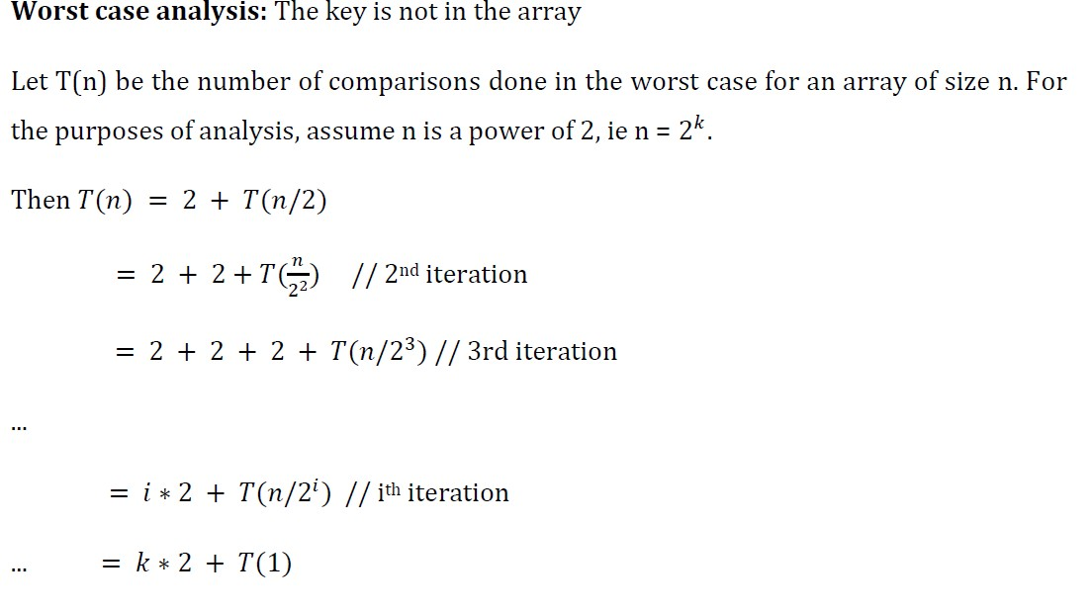
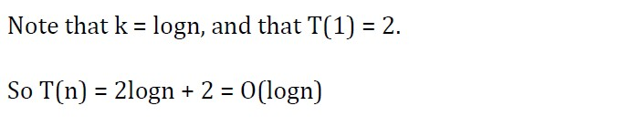

Slide 28

Bubble sort analysis
int i, j, temp;
for(i=0; i<n; i++)
{
for(j=0; j<n-i-1; j++)
{
if( a[j] > a[j+1])
{
temp = a[j];
a[j] = a[j+1];
a[j+1] = temp;
}
}
}

Slide 29
Worst Case: In Bubble Sort, n-1 comparisons will be done in 1st pass, n-2 in 2nd pass, n-3 in 3rd pass and so on. So the total number of comparisons will be
(n-1)+(n-2)+(n-3)+.....+3+2+1
Sum = n(n-1)/2
Hence the complexity of Bubble Sort is O(n²).
Best-case Time Complexity will be O(n), it is when the list is already sorted.

